Slide 1
PLACENTA!!

Slide 2
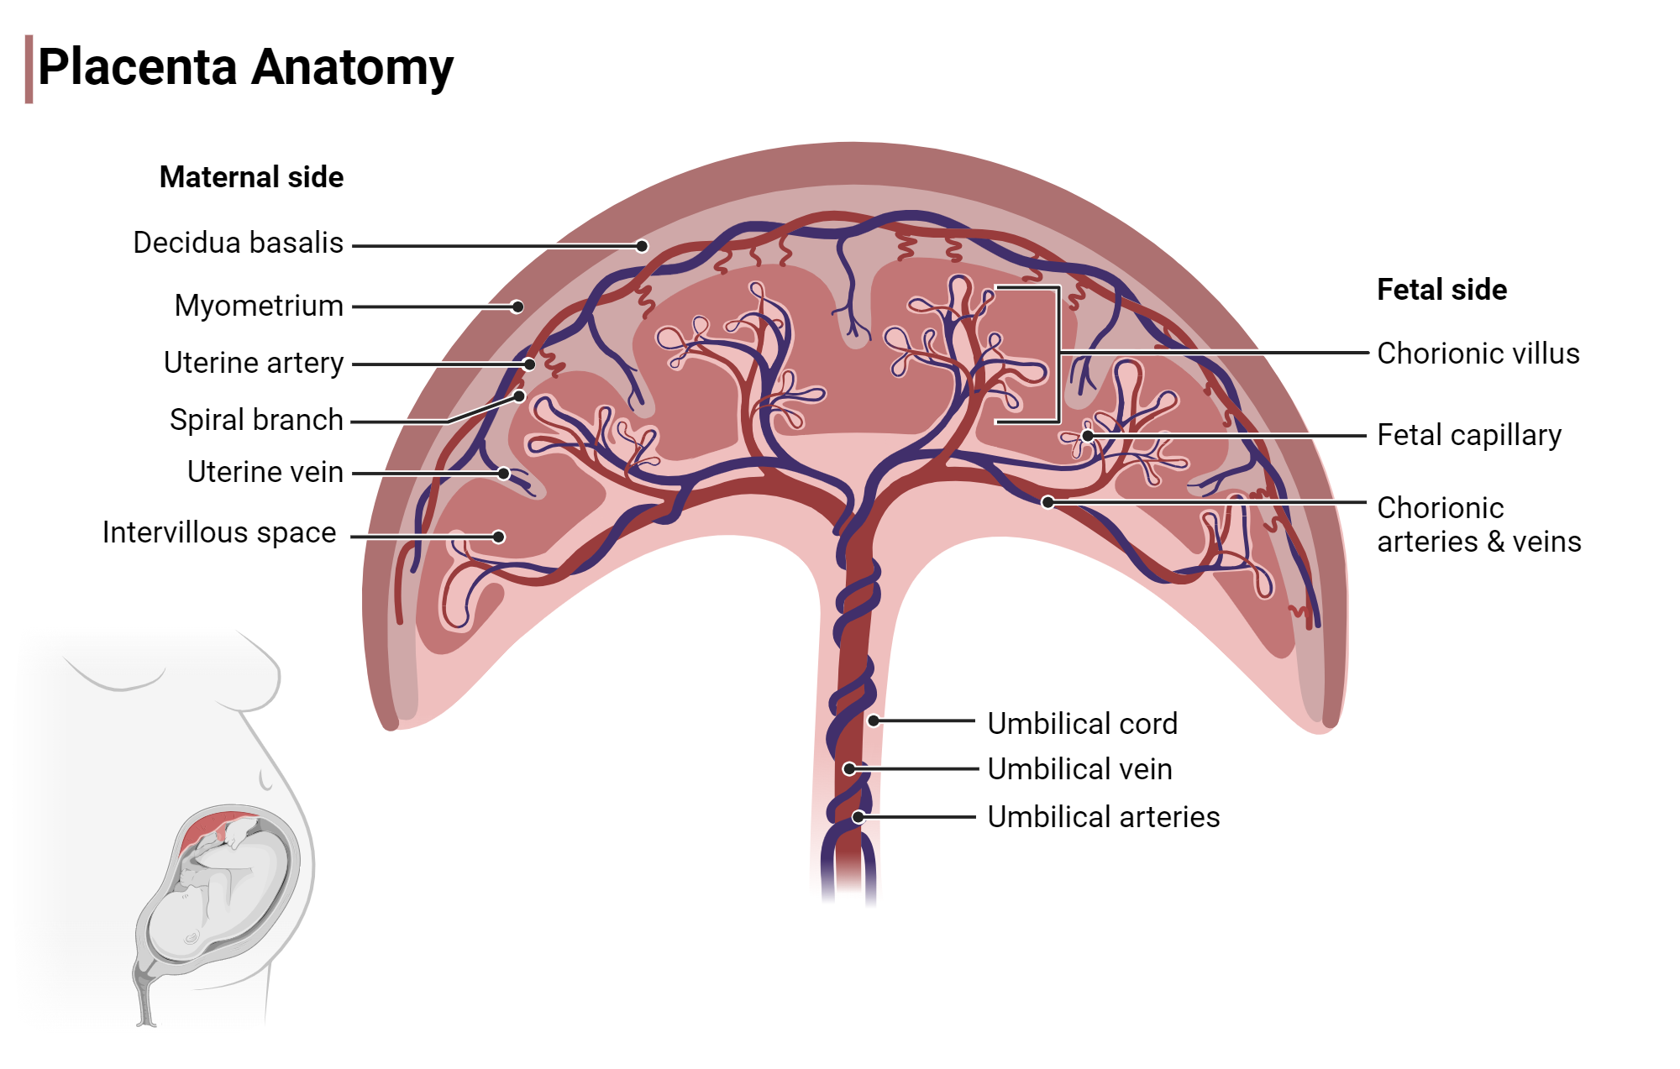
Notes:
https://www.biorender.com/template/placenta-anatomy

Slide 3
Clinical population:
pregnant women with known placental blood flow complications.

Slide 4
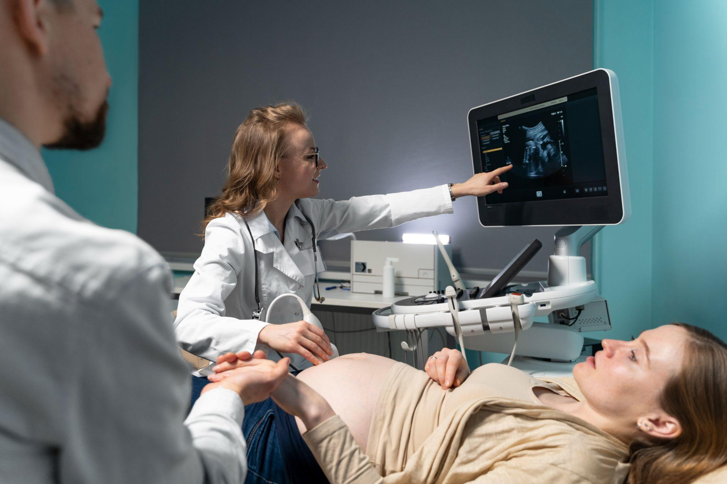
Notes:
https://www.freepik.com/free-photo/gynecologist-performing-ultrasound-consultation_24749419.htm#fromView=keyword&page=3&position=31&uuid=b8313375-b017-4c60-875a-8cd5cdd4a287&query=Pregnancy+ultrasound

Slide 5
Currently, there is no clinically available, noninvasive system to continuously monitor placental blood flow.
TEAM 1
UNMET-NEED
Feb 7th, 2026

Slide 6
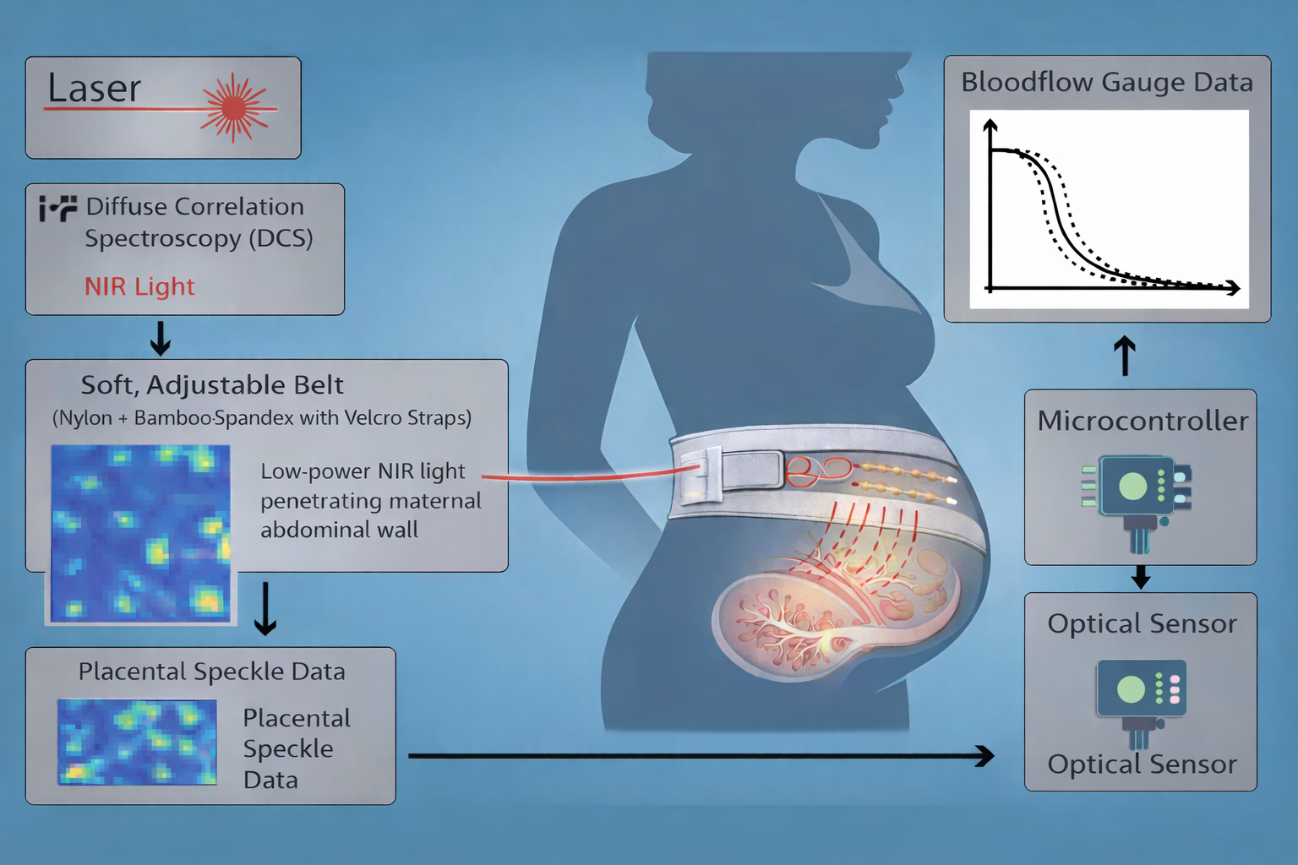
PlacenTra
TEAM ONE
INTRODUCTION
FEB 7TH, 2026
Noninvasive placenta blood flow monitoring using a DCS system.

Slide 7
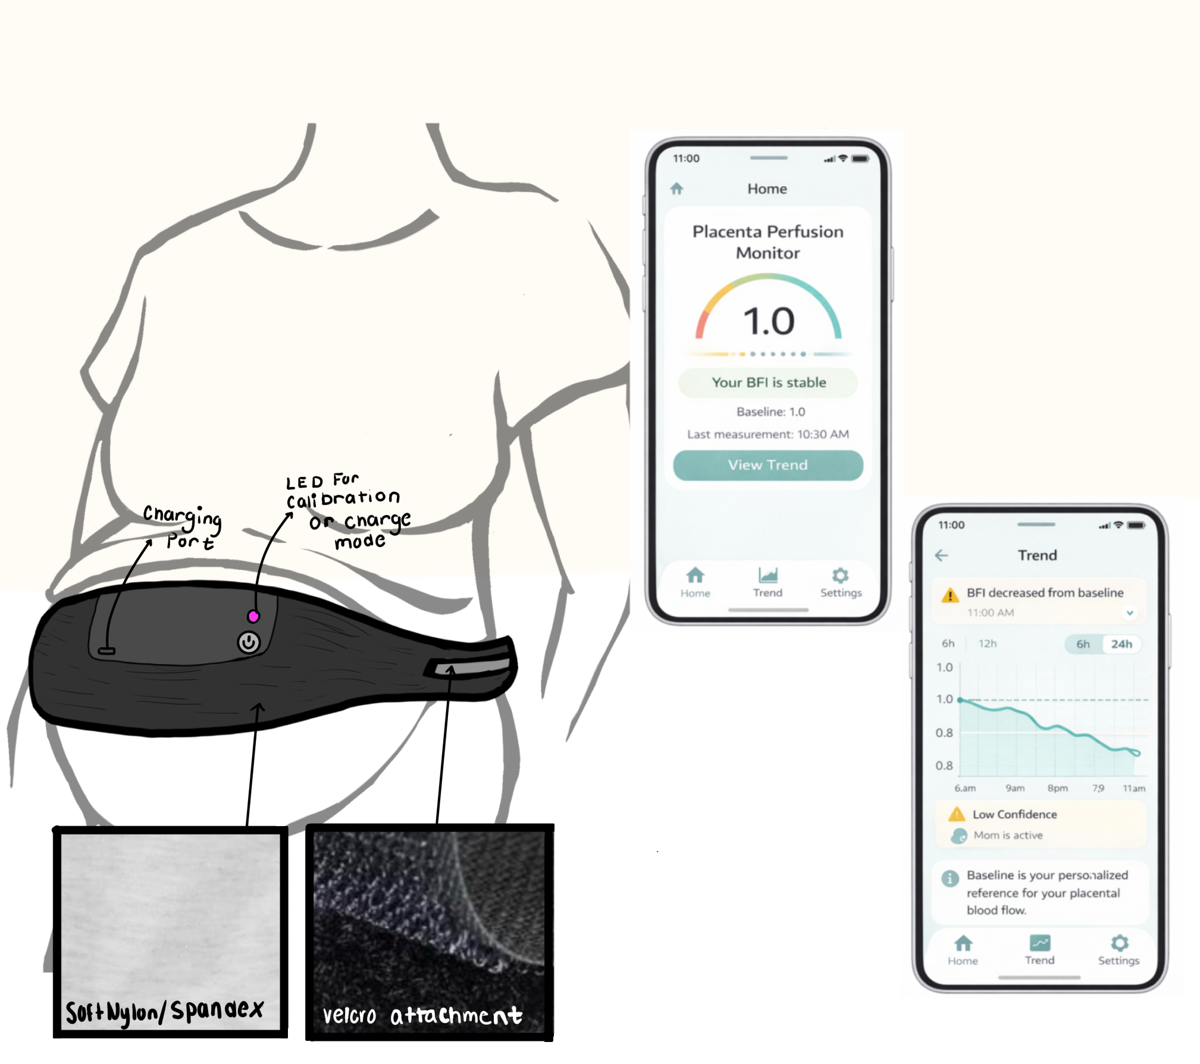

Slide 9
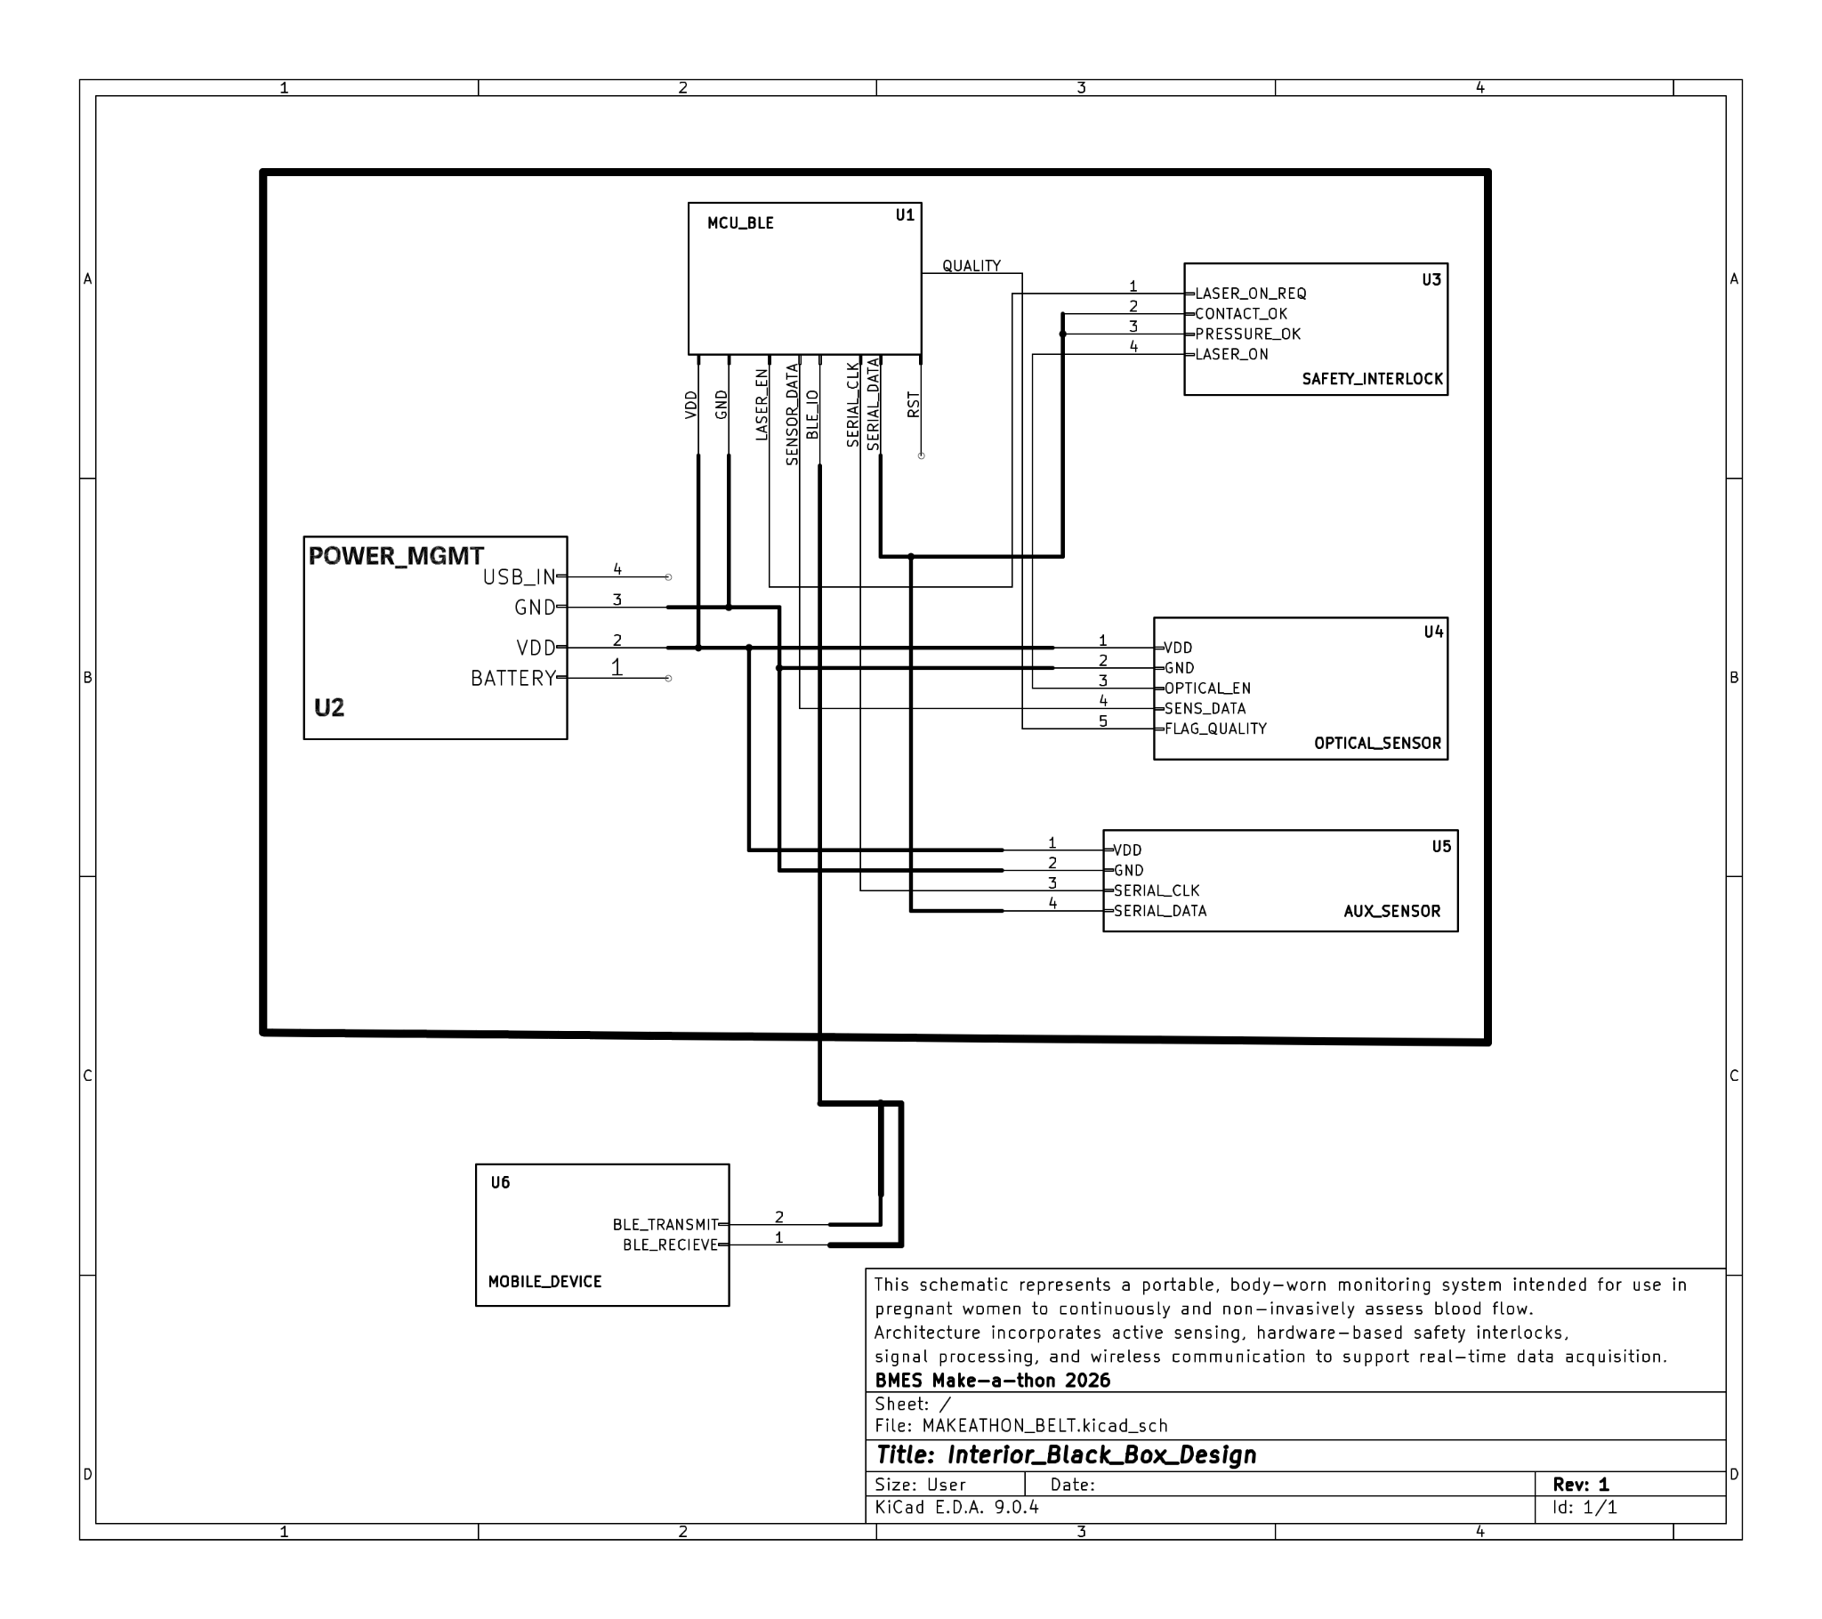
Hardware Implementation
TEAM ONE
HARDWARE
FEB 7TH, 2026

Slide 11

Companion App
(Software)
TEAM ONE
SOFTWARE
FEB 7TH, 2026

Slide 12
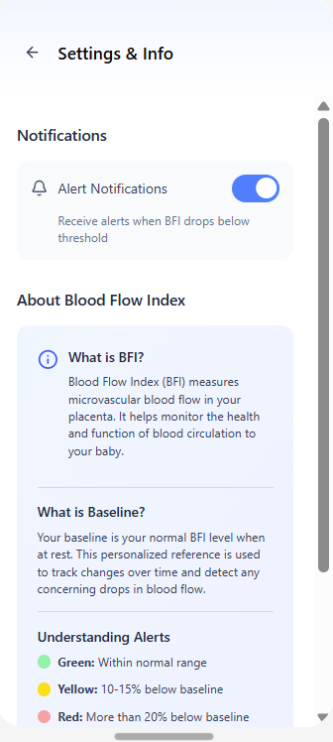
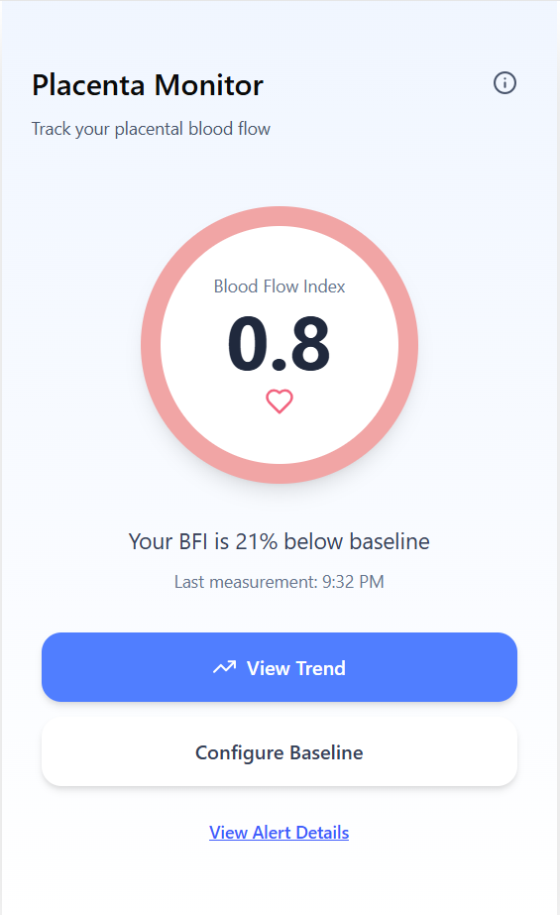
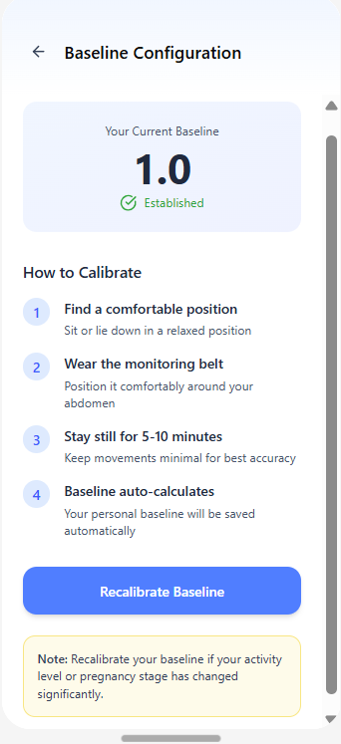
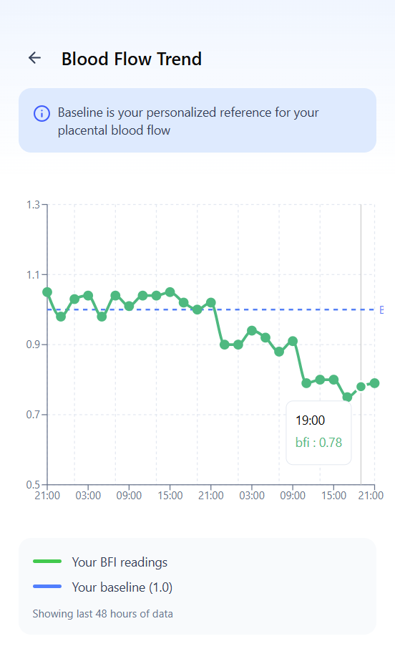
TEAM ONE
SOFTWARE
FEB 7TH, 2026

Slide 13
How does Placentra uphold power, cost, and sustainability?
TEAM ONE
POWER, COST, SUSTAINABILITY
FEB 7TH, 2026

Slide 15
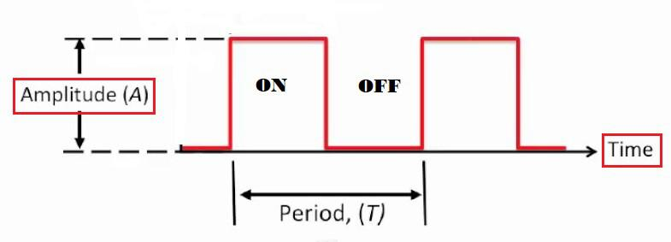
Power
TEAM ONE
Power, Cost, Sustainability
FEB 7TH, 2026
Low-power near-infrared light within safety limits
Non-invasive, safe for repeated use during pregnancy
Duty-cycled measurements reduce energy use
Once-daily recharging for everyday wear

Slide 16
Cost
TEAM ONE
Power, Cost, Sustainability
FEB 7TH, 2026
Off-the-shelf optical components
Low-power microcontroller
Reusable belt reduces recurring costs
Scalable, low-cost manufacturing

Slide 17
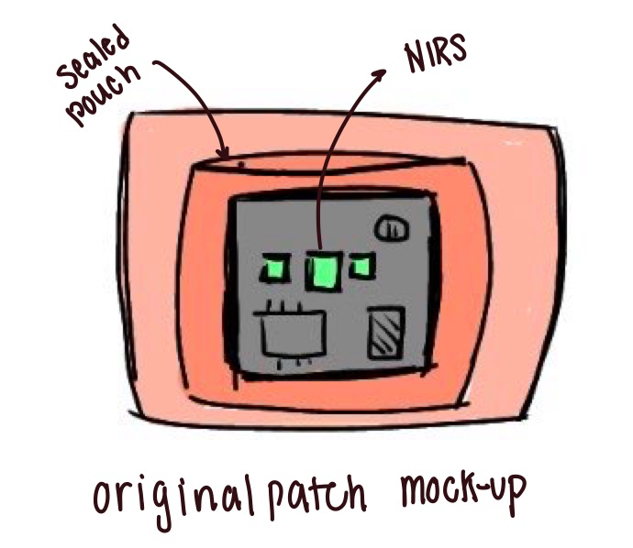
Sustainability
TEAM ONE
Power, Cost, Sustainability
FEB 7TH, 2026
Fully reusable hardware
Eliminates disposable adhesive waste
Energy-efficient operation
Lower long-term burden on healthcare systems

Slide 18
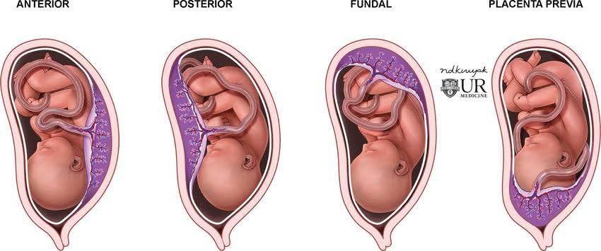
Limitations

Slide 19
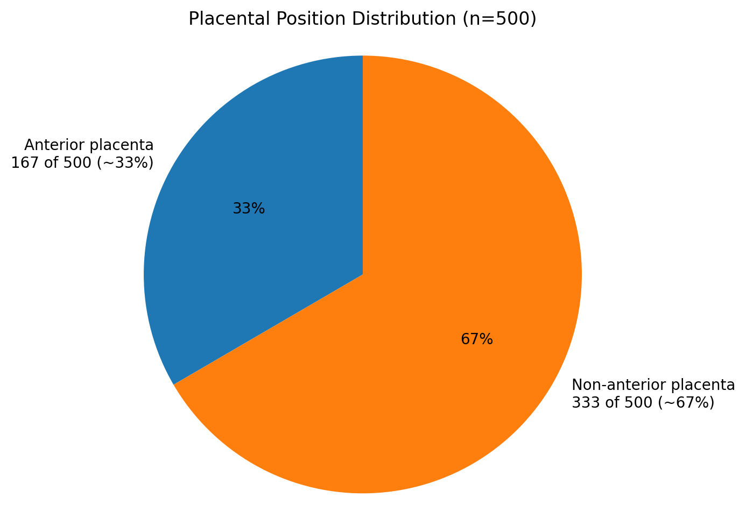
Source: Dr. Heather Bartos, MD (Be. Women’s Health & Wellness).

Slide 20
Improvements
TEAM ONE
Future
FEB 7TH, 2026
Enhanced Depth Sensitivity
Anatomical Personalization
Adaptive Signal Processing

Slide 21
In conclusion…
TEAM ONE
POWER, COST, SUSTAINABILITY
FEB 7TH, 2026

